Slide 1

Predictive Modeling for Alpha Steel
Key Factors Influencing Client Satisfaction in Steel Manufacturing
Tumma Karthikeyan

Slide 2

Project Introduction
Analyze Alpha Steel’s operations and customer engagement to identify strengths and areas for improvement.
The goal is to understand how digital transformation impacts client satisfaction within the Alpha steel industry.

Slide 3

Company Context
Alpha Steel is a key player in the Americas' steel market, producing materials for construction, automotive, and appliances.
Embracing technology, they launched a digital platform in 2016 to enhance client service and streamline operations.
The digital strategy includes classifying customers to better meet diverse needs and improve their market approach.

Slide 4

Dataset Overview
The dataset from Alpha Steel's database includes 17,944 entries across 23 columns, meticulously structured for detailed analysis.
It encompasses critical metrics on client interactions, such as web usage and purchase history, which will be pivotal in our predictive modeling.

Slide 5
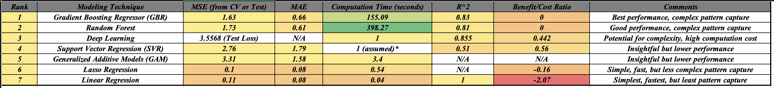
Summary of the models

Slide 6

Model Evaluation and Efficiency
The Gradient Boosting Regressor (GBR) and Random Forest models top the performance ranking, adept at capturing complex data patterns in client satisfaction metrics.
GBR showcases the best trade-off between accuracy and computational time, a crucial factor for real-time customer experience improvements.
Linear Regression, although fastest, shows limitations in pattern recognition, indicating its suitability for basic trend analysis rather than complex predictions.
Implications for Alpha Steel:
Prioritize GBR for its precision in predicting client satisfaction, essential for formulating targeted customer retention strategies.
Reserve Linear Regression for quick, preliminary assessments to gauge overall satisfaction trends.

Slide 7

Variable Importance Ranking
The analysis ranked 'SESSIONS_YEAR' highest, indicating frequent site visits correlate strongly with client satisfaction.
AVERAGE_ACTIONS and MAXNUMBER_PAGES_VISITED followed, suggesting the quality and depth of online engagement are key.
TONS_ONCART' was ranked lower but still significant, linking potential purchases to satisfaction levels.
Business Implications:
Alpha Steel can focus on enhancing website interactivity to increase client visits and actions.
Improving the user experience to encourage deeper exploration of the site could lead to higher engagement and satisfaction.
Streamlining the online shopping experience may directly impact the potential sales volume.

Slide 8

Actionable Insights from Variables
To improve SESSIONS_YEAR, Alpha Steel should implement strategies for repeat website visits, such as regular updates and personalized content.
AVERAGE_ACTIONS suggests investing in website features that encourage interaction, like live chat support or interactive product demos.
For TONS_ONCART, simplifying the checkout process and offering tailored product recommendations could convert potential interest into sales.
Contextual Consideration:
These actions are grounded in the steel industry's shift towards digitalization, where enhanced customer experience is essential.
Insights drawn from the dataset align with industry best practices of leveraging digital platforms for improved client engagement.

Slide 9

Thank you

